Slide 1

Virtual Water
IWME 502
By : Nishtha Chawla & Ruiwen Li

Slide 2

Introduction
VIRTUAL WATER is a term that links water, food, and trade. It is the amount of water that is embedded in food and products needed for its production.
If one exports a water intensive product to other country, it exports water in virtual form.
Virtual water is the “hidden” water cost embedded in producing consumer products. When we export these products, we are actually exporting our water supply. [2]
Notes:
Water Content in Orange is around 86%. For every 100g of orange it holds 86g of water. It has been calculated that to produce one orange 50 litres of water is needed throughout the whole supply chain.

Slide 3
Background
To produce 1 kg of wheat, we need about 1,000 litres of water. For livestock products, we need about five to ten times as much [1]
“Virtual Water” was introduced in 1993 by J.A. Allan
Indicate the amount of water made available in the global system through agricultural commodity trade
In 2003, A.Y. Hoekstra expanded the definition of virtual water[1]
To denote the water used in the production process of an agricultural or industrial product, “including the water applied in the use and waste stages of the product.”
Notes:
https://canadians.org/sites/default/files/publications/virtual-water-0511.pdf
Here is a little bit of background.
J.A. Allan, a geography professor at King’s College London, to indicate the amount of water made available in the global system through agricultural commodity trade. I

Slide 4
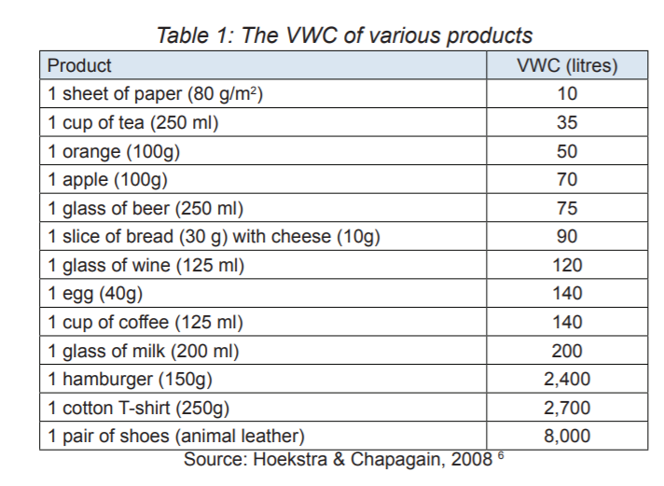
Virtual Water Content
The virtual water content of a product (a commodity, good, service) is the volume of fresh water used to produce the product, measured at the place where the product was actually produced[1]
Notes:
Each product has a virtual water content value associated with it. It is the volume of fresh water that is used to produce that product. And it is measure at point of origin. Here is the list of VWC of some common products.

Slide 5
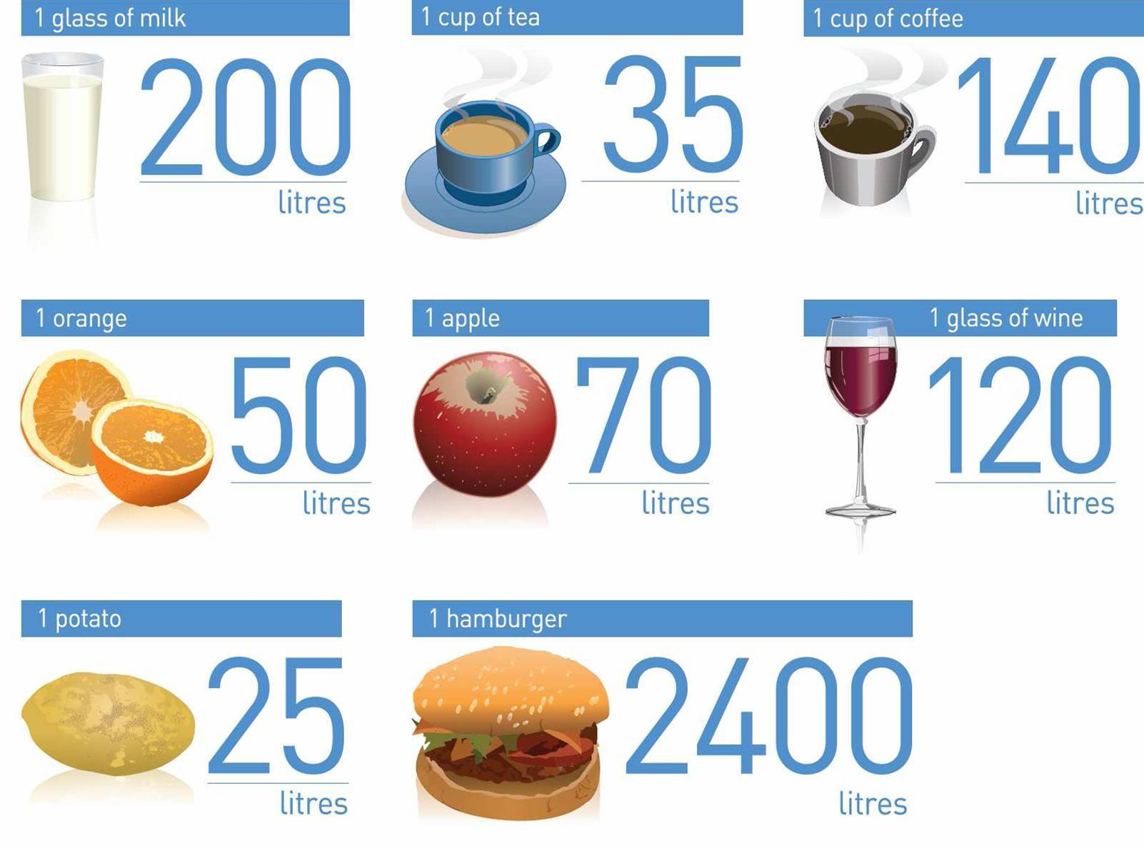
Typical water use
A cup of coffee uses approximately 140 liters of virtual water to produce.
A hamburger uses approximately 2,400 liters of virtual water
Notes:
(Water is consumed during the entire process, from growing feed crops for the cows, to slaughtering and processing the meat. Water is consumed throughout the production process, from growing to producing, to packaging and shipping.)

Slide 6
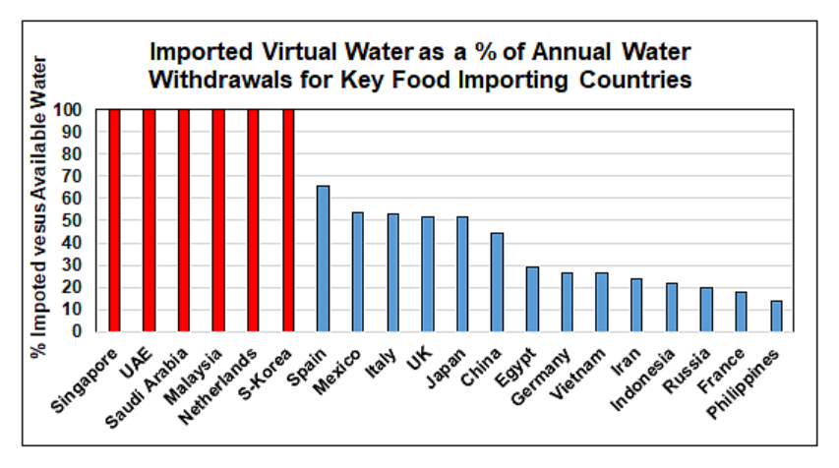
Virtual Water Imported Compared to Annual Water Withdrawals
http://ubclfs-wmc.landfood.ubc.ca/webapp/WID/course/water-food-security-2/virtual-water-import-and-export-69/
Notes:
http://ubclfs-wmc.landfood.ubc.ca/webapp/WID/course/water-food-security-2/virtual-water-import-and-export-69/
So if one country is exporting crops to another, it is basically displacing water in form of agricultural commodity
Germany, for example is not a waterscarce country, but it is a net importer of virtual water. It leaves its water footprint in countries like Brazil, the Ivory Coast and India, from which it imports coffee, cotton and other goods.9 The United Kingdom imports two-thirds of its water footprint. Saudi Arabia and Japan import most of their water footprint. Wealthy countries are able to maintain their water security by relying on countries from the Global South for water-intensive products. They see virtual water as an alternative source of water.
https://canadians.org/sites/default/files/publications/virtual-water-0511.pdf

Slide 7
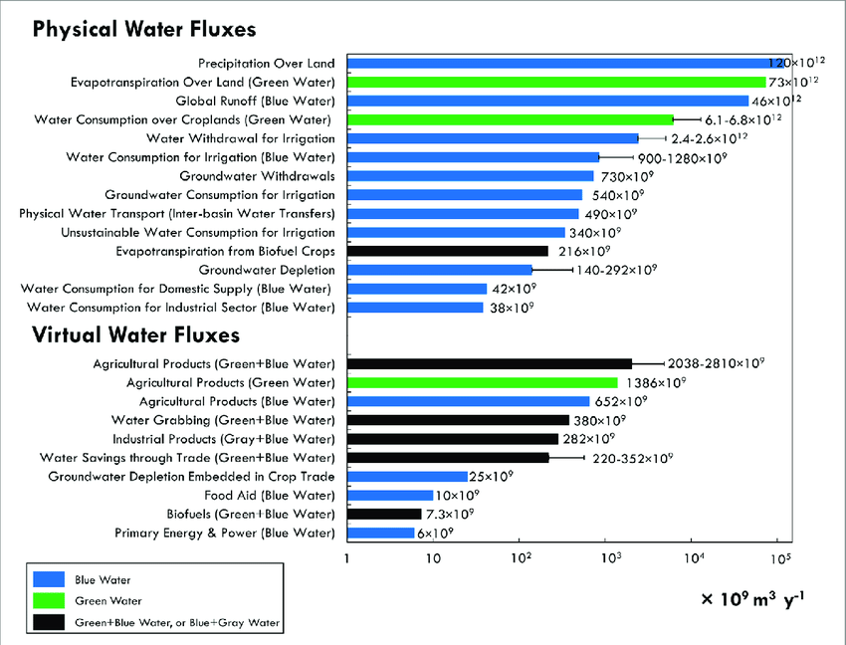
Virtual Water Fluxes
sS
Notes:
https://www.researchgate.net/figure/Physical-and-virtual-water-fluxes-Interval-bars-are-computed-by-using-different-values_fig9_331031653
Source: D'Odorico, Paolo & Carr, Joel & Dalin, Carole & Dell'Angelo, Jampel & Konar, Megan & Laio, Francesco & Ridolfi, Luca & Rosa, Lorenzo & Suweis, Samir & Tamea, Stefania & Tuninetti, Marta. (2019). Global virtual water trade and the hydrological cycle: Patterns, drivers, and socio-environmental impacts. Environmental Research Letters. 14. 10.1088/1748-9326/ab05f4.

Slide 8
Virtual Water Fluxes- Contd.
The green water footprint is the volume of water evaporated from the global green water resources (rainwater stored in the soil as soil moisture).
The blue water footprint is the volume of freshwater that evaporated from the global blue water resources (surface water and ground water) to produce goods and services consumed by the individual or community.
The grey water footprint is the volume of polluted water that is associated with the production of all goods and services for the individual or community.
Notes:
The grey water can be estimated as the volume of water that is required to dilute pollutants to such an extent that the quality of the water remains at or above agreed water quality standards.
Source: D'Odorico, Paolo & Carr, Joel & Dalin, Carole & Dell'Angelo, Jampel & Konar, Megan & Laio, Francesco & Ridolfi, Luca & Rosa, Lorenzo & Suweis, Samir & Tamea, Stefania & Tuninetti, Marta. (2019). Global virtual water trade and the hydrological cycle: Patterns, drivers, and socio-environmental impacts. Environmental Research Letters. 14. 10.1088/1748-9326/ab05f4.

Slide 9
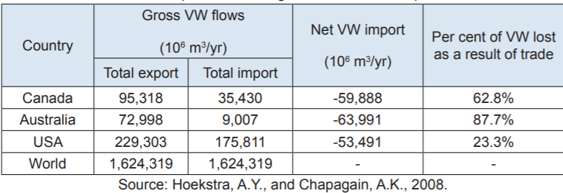
Major Findings
Canada’s net annual virtual exports (exports minus imports) amount to approx. 60 Bm3 (billion cubic metres) [1]
Over 60 per cent of Canada’s total agricultural exports and their embedded water go to the U.S [1]
Every year, Canada uses (and destroys) 1 billion, 95 million cubic metres of fresh water in the production – mostly for export to the U.S [1]
Notes:
https://canadians.org/sites/default/files/publications/virtual-water-0511.pdf
This amount is enough to fill the Rogers Centre in Toronto that has a volume of 1.6 Mm3 , approximately 37.5 thousand times.
Canada ranks second after Australia as a net exporter and these exports consist mostly of cereals and livestock products

Slide 10

Why is it important?
For water scarce countries it could be attractive to achieve water security by importing water intensive products[3]
Virtual water helps us understand the dependencies our economies have on others’ resources
VW is an indicator that helps make better policy decisions[3]
Lets the market decide where products should be produced and consumed
Can support political stability through food[3]
Allows for transfer of water from water-rich areas to water-poor areas
Notes:
Helps understand the impact of our actions on resources
2. If a water-intensive commodity is traded from an area where it is produced with high water productivity (resulting in products with low VWC) to an area with lower water productivity, there should be an associated global water saving.
4. A country may select energy security by using its natural resources to produce electricity in exchange for food security by importing food. The water footprint and its translation into virtual water can illuminate these choices and their inter-dependencies.
https://waterfootprint.org/en/water-footprint/national-water-footprint/virtual-water-trade/

Slide 11

Need of VW
Our fresh water heritage is at risk from:
1. Lack of government concern
2. Mapping and research on our groundwater and surface water supplies
3. Almost total absence of policy intervention by any level of government to set conditions on access to fresh water sources for export-driven production[1]
Notes:
https://canadians.org/sites/default/files/publications/virtual-water-0511.pdf
Although Canada is home to approximately 6.5 per cent of the world's fresh water, much of it is unevenly distributed across a vast landscape and many watersheds are under great stress. Canada’s fresh water resources are grossly mismanaged. Due to neglect by successive governments, many water bodies are now on the verge of ecological disaster.
Most of these virtual water exports go to the United States and represent a huge environmental cost that is not reflected either in the pricing of these commodities or in the calculations of the costs and benefits of free trade. The so-called NAFTA “benefits” claimed by some industries and sectors come at the expense of Canada’s fresh water heritage.

Slide 12
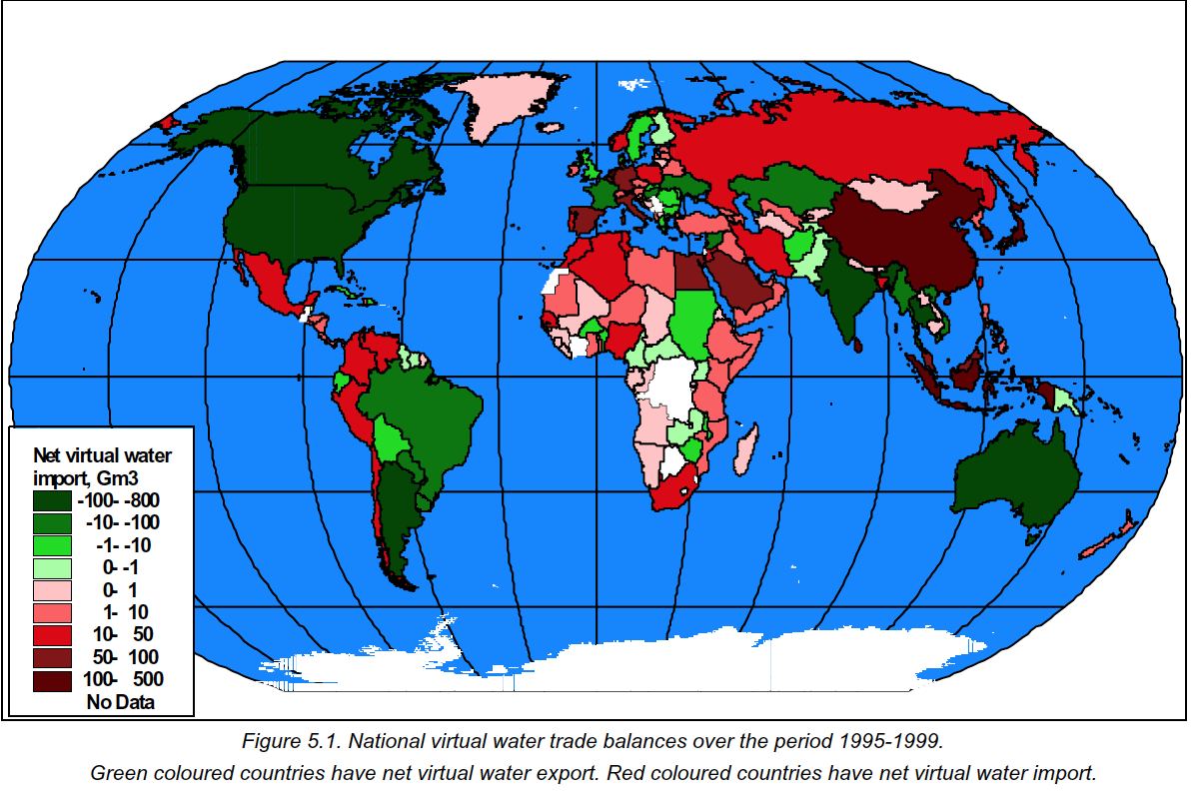

Slide 13
Virtual Water Transfer
Food trading driven by :
water resources limitation
Artificial light and heat requirements
The differences in water demand to grow same crops in different region
Example:
Growing wheat in France needs 1/10th of the water required to grow the same crop in Moroco (Mekonnen and Hoekstra,2012 ).
Notes:
https://www.sciencedirect.com/topics/agricultural-and-biological-sciences/virtual-water

Slide 14
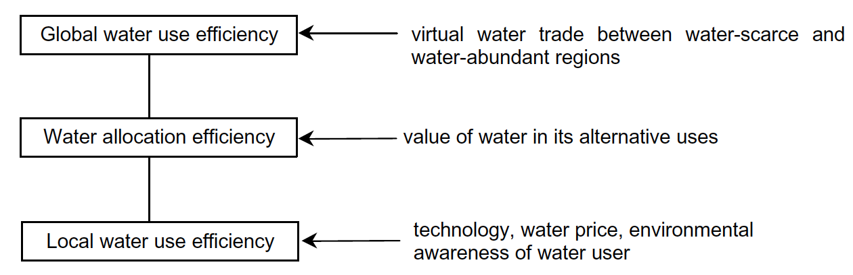
Virtual Water Trade
Advantages:
Increase food productions’ resilience to climate variability
Mitigate temporal water shortages due to regional crop failure
Limitations:
Fairness of the trade

Slide 15
Virtual Water Trade
From 1995-1999, virtual water trade between nations was 695 Gm3/Yr, while total water uses by crops in the world is estimated to be 54,000 Gm3/Yr.
→ 13% of the water used by crop production are for export. (A.Y. Hoekstra and P.Q. Hung, 2005)
Net water export: United States, Canada, Thailand, Argentina, and India
Net water import: Sri-Lanka, Japan, the Netherlands, Korea, China

Slide 16
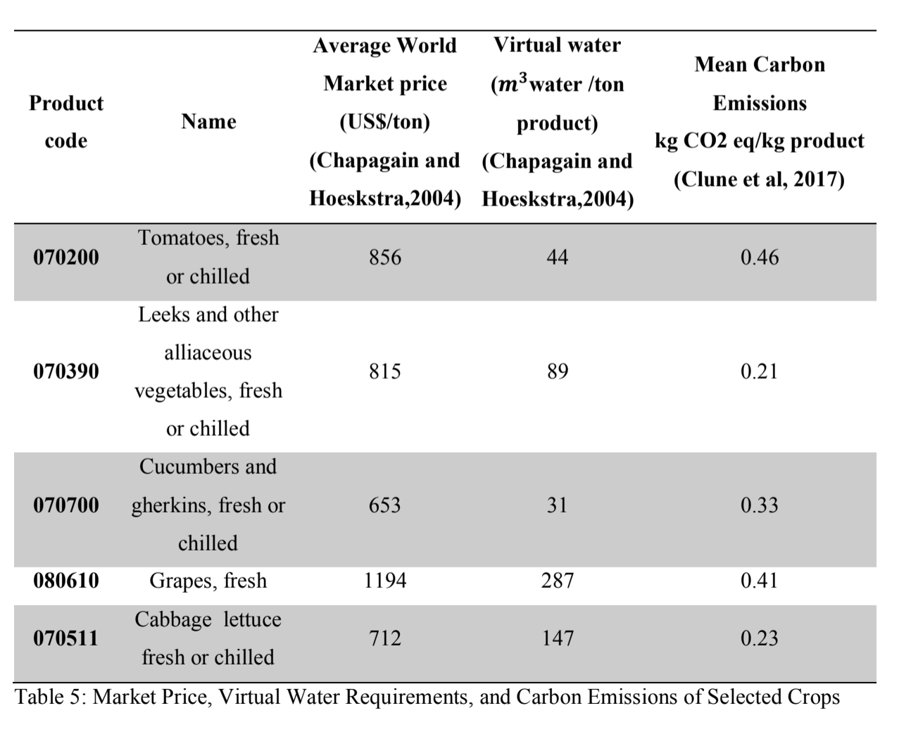
Canada Perspective
Ideal export item:
Low virtual water requirements
High market price
Lower environmental impact
Crops are preferred as livestock products have high GHGs and consumes lots of water during their lifetime

Slide 17
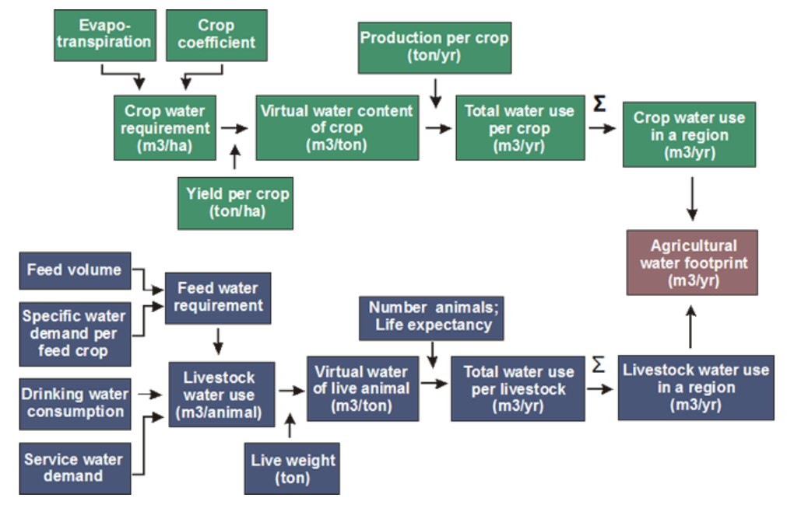
Technique to measure – Overall Scheme
Notes:
http://ubclfs-wmc.landfood.ubc.ca/webapp/VWM/course/food-export-virtual-water-3/virtual-water-calculation-9/

Slide 18
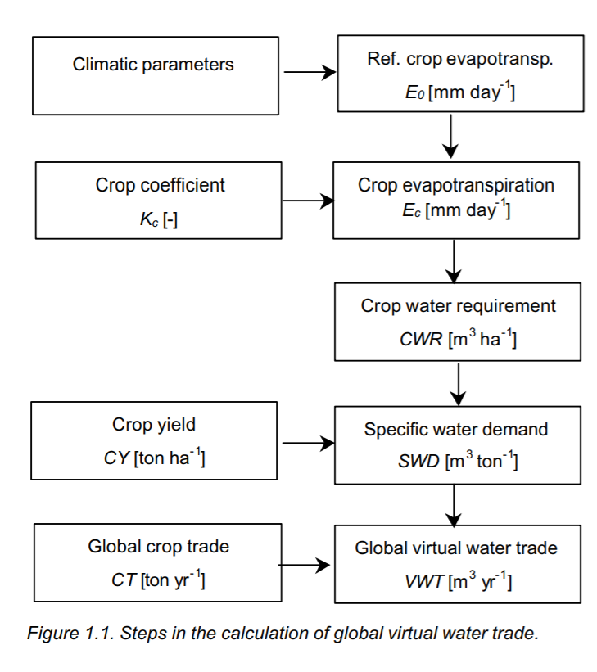
Calculation of global virtual water trade
For any product m, the virtual water content (or water footprint) is obtained by considering the volume of water needed to produce m in a given country, including the contributions of rainfall (green water), surface water and groundwater (blue water). The grey water, which is an indicator of freshwater pollution[3]
Notes:
https://waterfootprint.org/media/downloads/Report11_1.pdf

Slide 19
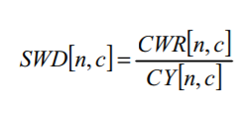

Calculation-Specific Water Demand
SWD denotes the specific water demand (m3 ton-1) of crop c in country n, CWR the crop water requirement (m3 ha-1) and CY the crop yield (ton ha-1)
The crop water requirement CWR (in m3 ha-1) is calculated from the accumulated crop evapotranspiration ETc (in mm/day) over the complete growing period. ETc follows from multiplying the ‘reference crop evapotranspiration’ ET0 with the crop coefficient Kc
Notes:
https://waterfootprint.org/media/downloads/Report11_1.pdf

Slide 20
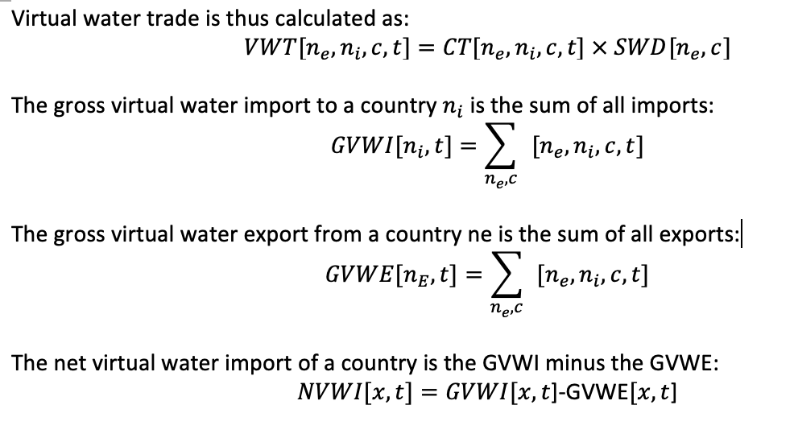
Calculation-Virtual Water Trade

Slide 21
Limitations of Virtual Water Measure
It relies on an assumption that all sources of water, whether in the form of rainfall or provided through an irrigation system, are of equal value.
It implicitly assumes that water that would be released by reducing a high water use activity would necessarily be available for use in a less water-intensive activity [5]
It fails as an indicator of environmental harm nor does it provide any indication of whether water resources are being used within sustainable extraction limits. [5]
Notes:
. For example, the implicit assumption is that water used in rangeland beef production would be available to be used to produce an alternative, less water-intensive activity. As a practical matter this may not be the case, nor might the alternatives be economic.
https://en.wikipedia.org/wiki/Virtual_water

Slide 22
Challenges of the virtual water concept
Decisions regarding imports and exports are not based on water consumptions. Consideration include: input and output prices, exchange rates, product quality, supply reliability, production technology, domestic demand, and geopolitics.
Importing virtual water does not mean saving water. A country cannot save water they don't have.
All net export countries have invested massively in agriculture development. They do not export because they have surplus water.

Slide 23
References
[1] [Canadians.org, 2019. [Online]. Available: https://canadians.org/sites/default/files/publications/virtual-water-0511.pdf. [Accessed: 21- May- 2019].
[2] "Virtual Water", Food & Water Watch, 2019. [Online]. Available: https://www.foodandwaterwatch.org/insight/virtual-water. [Accessed: 21- May- 2019].
[3]"Virtual water trade", Waterfootprint.org, 2019. [Online]. Available: https://waterfootprint.org/en/water-footprint/national-water-footprint/virtual-water-trade/. [Accessed: 21- May- 2019].
[4] "Trade and Virtual Water - ppt download", Slideplayer.com, 2019. [Online]. Available: https://slideplayer.com/slide/9341579/. [Accessed: 21- May- 2019].
[5]"Virtual water", En.wikipedia.org, 2019. [Online]. Available: https://en.wikipedia.org/wiki/Virtual_water. [Accessed: 21- May- 2019].
[6]Hoekstra, A. Y., & Mekonnen, M. M. (2012). The water footprint of humanity. Proceedings of the National Academy of Sciences of the United States of America, 109(9), 3232-3237. doi:10.1073/pnas.1109936109
[7]Hoekstra, A. Y., & Hung, P. Q. (2005). Globalisation of water resources: International virtual water flows in relation to crop trade. Global Environmental Change, 15(1), 45-56. doi:10.1016/j.gloenvcha.2004.06.004
[8] Chapagain and Hoeskstra (2004). Water Footprints of Nations: Volume 2 Appendices. Retrieved Feb 24, 2019 from:https://waterfootprint.org/media/downloads/Report16Vol2.pdf

Slide 24

Thank you!
Questions?

Slide 25
Fluxes
The blue water footprint is the volume of freshwater that evaporated from the global blue water resources (surface water and ground water) to produce goods and services consumed by the individual or community.
The green water footprint is the volume of water evaporated from the global green water resources (rainwater stored in the soil as soil moisture).
The grey water footprint is the volume of polluted water that is associated with the production of all goods and services for the individual or community.
Source: D'Odorico, Paolo & Carr, Joel & Dalin, Carole & Dell'Angelo, Jampel & Konar, Megan & Laio, Francesco & Ridolfi, Luca & Rosa, Lorenzo & Suweis, Samir & Tamea, Stefania & Tuninetti, Marta. (2019). Global virtual water trade and the hydrological cycle: Patterns, drivers, and socio-environmental impacts. Environmental Research Letters. 14. 10.1088/1748-9326/ab05f4.
Notes:
The grey water can be estimated as the volume of water that is required to dilute pollutants to such an extent that the quality of the water remains at or above agreed water quality standards.

